Slide 1
Effective Business Process Modeling
Desmond D’Souza
512-689-8496
desmond.dsouza@kinetium.com

Slide 2
Introduction
Present an approach to business process modeling that is
Clear
Simple
Comprehensive
Effective
“Big Picture” view with just enough detail to be clear
About me
20+ years in software and enterprise architecture
Last 12 years mostly on IT systems for large companies
Active in modeling standards, Board of OMG, conferences
Kinetium helps create business-aligned architectures

Slide 3
Outline
Walkthrough of Example
Goals - The Missing “Why”
The Modeling Framework
Pragmatics
Summary

Slide 4
Outline
Walkthrough of Example
Finding Process Boundaries
Processes have Instances
Activities Belong in Processes
Processes Interact
Process Instances are Interlinked Objects with Attributes
Object Attributes define Information Model, GUIs, & more

Slide 5
Managing Products and Releases
We manage a product company with a range of products. Products change over time, and we review proposed changes periodically for inclusion in a new product release.

Slide 6
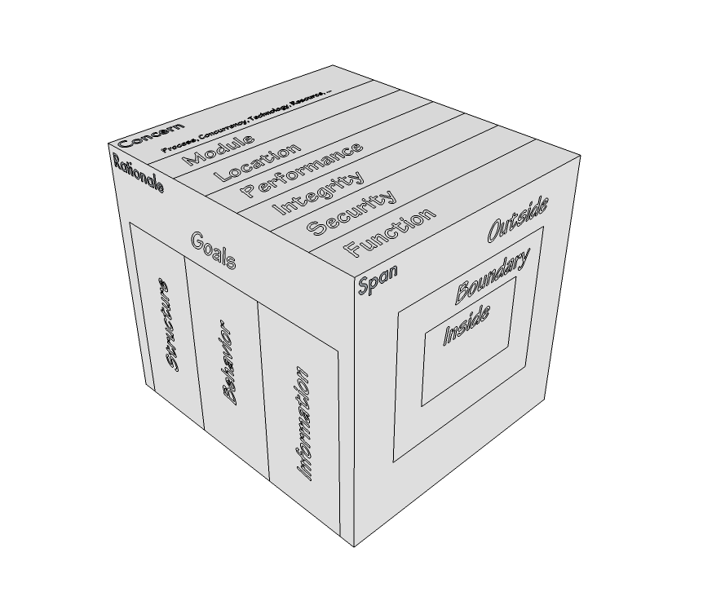
Preview of Example
Multiple Concerns (out of scope for us)
Ensure Change Set Integrity
Release Frequently
Prioritize High-Margin Products
Change Set Coordinator
Product Planner
Customer
… and Functions, Org-Structure
Handle a Change Request
Co-ordinate Change Requests
Assess Change Request Risk
Span or granularity:
Entire company? Roles?
Build a Product vs. Implement a Feature
Product has features, release plan
Release has Change Set, due date, risk level

Slide 7
What “Things” do our Processes manage?
Product
Change request
Release
Sale
Customer
We need a process for each of these.

Slide 8
What is in a Process?
State: where the process has reached, what information is available
Event: something that “happens” e.g. a state is reached, some time passes, message received …
Activity: performed by some Role to move the process along
Gateway: different ways to control flow along the process

Slide 9
A Process Has Instances
Draw
Write
Call
Handle a Product is a Process
It spawns many instances that evolve separately
Each focused on one Product – Draw, Write, Call
Each in its own state – Pre-Launch, Active, Maintain-Only…
Anything done is performed in process instances

Slide 10
Where to Place Each Activity and Concern?
Handle a Product
Handle a Change Request
Draw
2
Change Req. 17
Write
Change Req. 4
1
Call
Change Req. 78
3, 4, 5 ??
Handle a Release
R 1.1 Draw
R 1.2 Draw
Implement Change Req. 4
Evaluate long-term feature set for Draw
Determine Relative Priority of Change Req. 78
Confirm availability of Change Req. 4 for release R1.2
Decide and start a new Change Request #98
R 3.0 Write

Slide 11
So, We Also Need Co-Ordination Processes
Handle a Change Request
Change Req. 17
Change Req. 4
Change Req. 78
A new
Change Req.
Co-ordinate, allocate shared resources, start new…
Locate this process based on scope of co-ordination
E.g. Co-ordinate changes within scope of a release
Possibly embed in Handle a Release process

Slide 12
Processes Interact, Synchronize, Escalate, …

Slide 13
Process Is Object with Attributes
Objects with attribute values and links to other objects
Object attributes evolve through process
Every process instance is an object
Not every object is an interesting process

Slide 14
Terms in Process / Activity Defined Formally
Model of the subject matter of all processes
Model of information as it evolves through process
Attribute can represent complex information

Slide 15
Include Human Determined Attributes
High Risk is determined by human role in process
Risk is affected by other attributes
Model helps define a suitable GUI for that stage in process, or identify when human roles must collaborate informally

Slide 16
Validate with Scenarios
All aspects of the model can be validated with concrete cases or “scenarios”
Product Manager schedules Release
Release Manager evaluates Change Set
Release Manager monitors every Change Request risk
Change Request #3 becomes High Risk (details deferred, just state / event referenced)
…

Slide 17
Outline
Walkthrough of Example
Goals - The Missing “Why”
The Modeling Framework
Pragmatics
Summary

Slide 18
Process Model does not capture “Why”
Process is done a certain way for some reason
Process model captures
What the process and activity does
Who does it and in coordination with whom
What the activity is done on or with
Process model does not capture Why

Slide 19
Goals Model : Intent for “Complete” Coverage
Goal captures intent
Goal = “Dashboard” with “wires”
Refinement using Domain Properties and Sub-Goals capture Rationale for “How”
Strong objective completeness case
Goal
Refinement
Fact or Assumption
“wire”

Slide 20
Why Model Goals Precisely?
Confidence in True Desired Outcomes
Metrics and Monitoring
Rationale for Process Design
Goal “Refinement” eliminates Blind Spots
True Target for Architecture Review

Slide 21
Goal Models precisely locate Risks
Risk 1: Parent goal wrong
What the goal formally states is not what is actually desired
Risk 2: Assumptions or analysis of Domain Properties wrong
The actual domain properties do not match the assumption
Risk 3: Logic wrong
The combination of domain properties and sub-goals does not meet parent
Risk 4: Sub-goals are not a good problem decomposition
Combining the solutions to sub-problems will make a tangled mess

Slide 22
Outline
Walkthrough of Example
Goals - The Missing “Why”
The Modeling Framework
Pragmatics
Summary

Slide 23
Two Separate Aspects to Approach
Formal Framework
Goals
Viewpoints
Concerns
Models
Refinement
Architecture Styles
Process Pragmatics
Routes: Roadmap, Construction, …
Different Entry Points
Iterative and Incremental
List, Draft, or Dressed Templates
Guidelines
Checklists
A clear and uncompromising reference
Architecture always ties back to goals.
Different presentation suitable to audience
Clear and unambiguous architecture
Consistency rules across descriptions
Full of pragmatic compromise
Pictures? Tables? Text?
How to prioritize and focus work?
How much detail is appropriate and when?
How to show early value and reduce risk?

Slide 24
Goals on the Problem Domain
7: Multiple concerns: functionality, security, performance, technology…
2a: Goal - Factories supplied just in time from supplier warehouses
Functionality
Security
Performance
Technology
…
3: Refinement to sub-goals + domain properties on sub-domains
1: Problem Domain – factories, supplies, warehouses, partners, existing systems
3c: delivery: facts about a sub-domain
3b: predict production load, optimize supply schedule
3a: track inventories
4a: Model of solution and problem components grow together
4b: Scope of sub-goals get narrower.
Some assigned to components.
Factory Supply Optimizer
production load predictions
supply scheduling
supplier
inventory
deliveries
scheduling
predictions
2b: Model of problem domain starts here
5: Applications, Components, Connectors
– required or given properties for each
– end-to-end satisfaction of goals
6: Goals and Domain Model are refined in parallel, to granular goals and components

Slide 25
Goals “frame” An Architecture
Concerns can be about function, security, transactions, performance, etc.
Goals are desired properties of things in the problem or business domain
Goals (desired properties) Facts or Assumptions (given properties) can be about structure, behavior, information
Span or Granularity of interest: boundary of a box, or its outsides, or its insides

Slide 26
MAp Viewpoints
Process supports goals
Information supports goals, process
Domain / Biz
Architecture
1
Outside
Domain: Information, events
Goals
Process
Goals – success criteria
Black box assembly includes S,
Supports business model
Traceability
Mapped Black box Assembly (including S)
S
1
S
Component Architecture
Black box Spec (of S)
S
E
D
S
1
2
S: Information
Boundary
Architecture Styles: Principles, Patterns, Guidelines, Rules
Black-box Specification (of S)
4
S: Behavior
3
Black box view of S
Architecture styles, patterns: across viewpoints, projects
White box view of S
sub-component s1…s3
Partitions behavior & information
1
2
S
S
Component Architecture
White box design (of S)
s2
Inside
s2
s1
3b
s1
s3
3a
s3
4
Information
Behavior
Each sub-component could be drilled-down if needed

Slide 27
EA : Federated Goals and Alignment
goal
fact
domain
Goals align between parent and child initiative
Domains align between parent and child initiative
One initiative’s Assumption may be other initiative’s Goal

Slide 28
Outline
Walkthrough of Example
Goals - The Missing “Why”
The Modeling Framework
Pragmatics
Summary

Slide 29
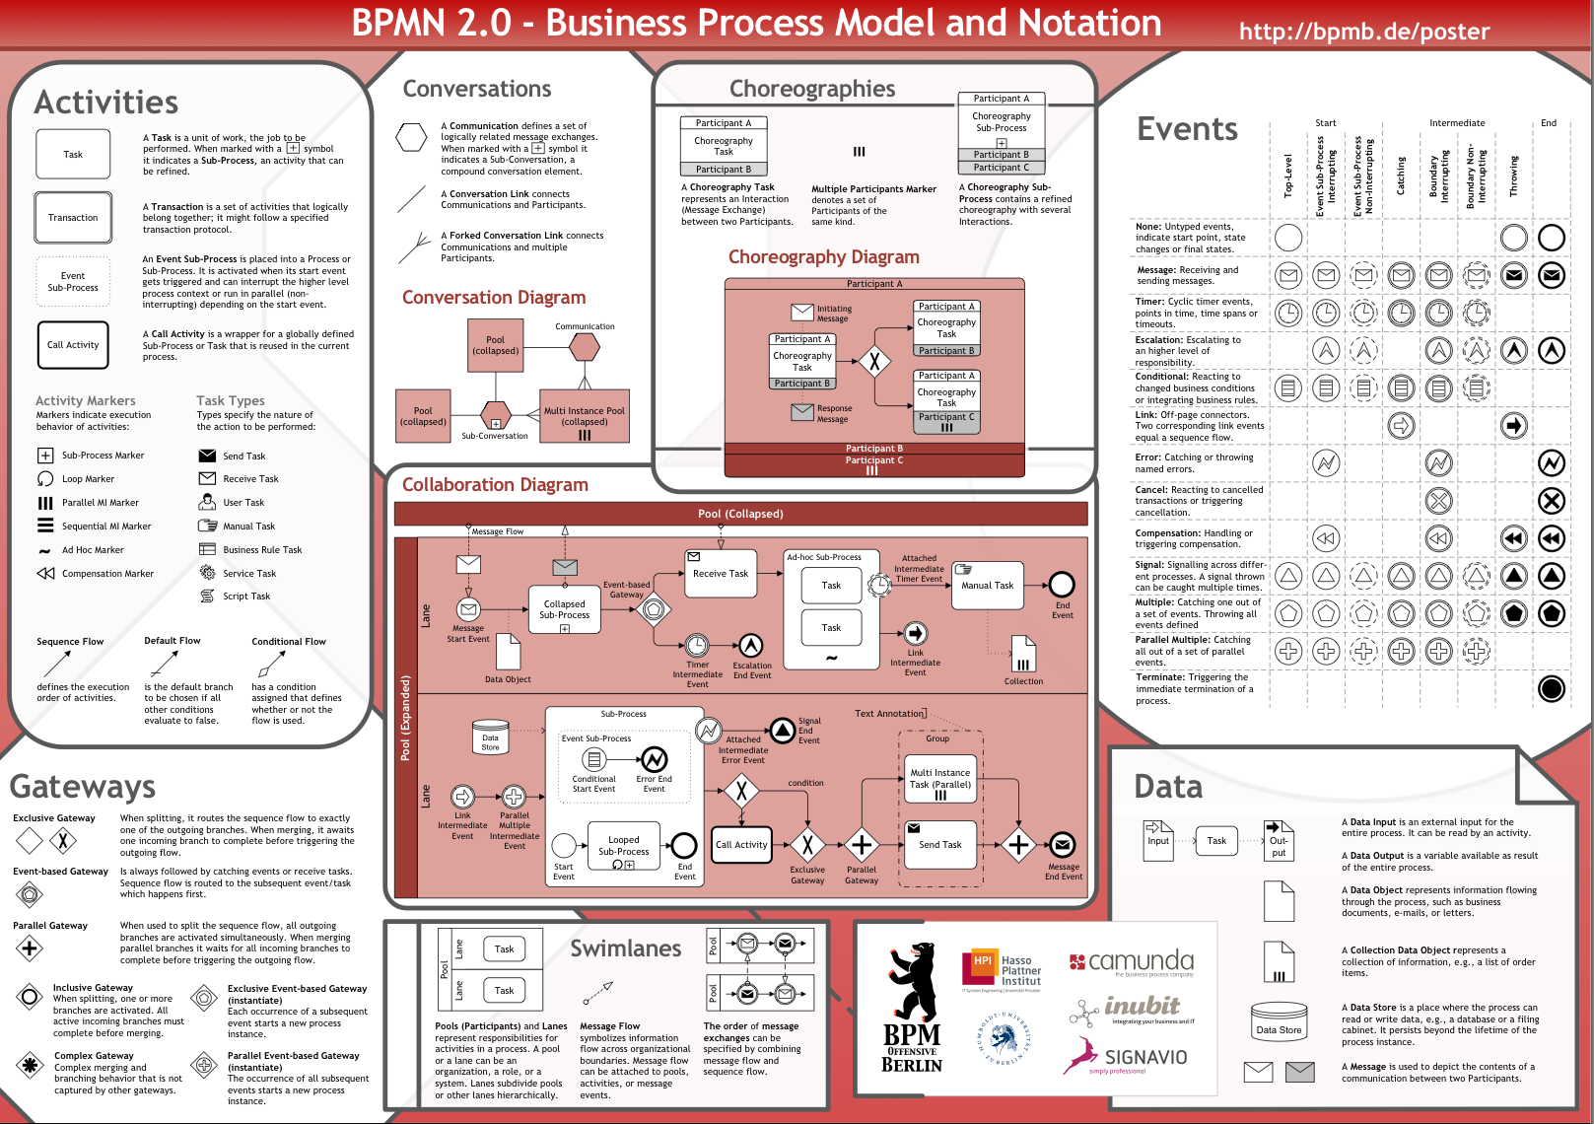
BPMN Pragmatics
Select notation subset
Use principled approach (such as ours)

Slide 30
Pragmatics vs. Formal Framework
Flexible Form
Diagrams vs. Tables vs. GUI sketches vs. Excel tables
High Level models
Easy to communicate and understand
Don’t be religious about a specific notation
Detailed models
Input for architecture work and implementation

Slide 31
Flexible Form and Detail
_{Fully Dressed Version}
Spec
1. Business Architecture | Business perspective on the problem, including activities, interactions, and business information.
2. Component Architecture – Black Box - White Box | Describes one (or more) large grained software components as a black box, with its relation with others in its environment, including its behavior and information responsibility.
 | Designs the “insides” of each black box software component as a collection of sub-components, specifies each one, and decides how they collaborate to fulfill black box responsibilities.
4. Technical Architecture | Designs the connectors between the components to support their designed interactions, the platforms to support the components, mapping both to technology.
5. Deployment Architecture | Designs the hardware structure (nodes, connections, devices, …) and which deployable software units will map onto the hardware to support component execution and communication.
6. Module Architecture | Designs the deployable compiled software units, and how they are generated from structured source units, that are in turn determined from the application and technical architecture.
Use case: make appointment
Actors: Scheduler, System, Billing System
Inputs: patient info, date, symptoms (from Scheduler)
insurance info (from Billing System)
Outputs: appointment info, cost, dentist (to Scheduler)
Trigger: Patient calls for appointment
Precondition: None
Postcondition: An appointment has been created for
patient with suitable dentist for date, to
cover planned treatments. Insurance and
cost estimates recorded.
_{Black}
_{box}
Use
Cases
_{List Version}
Use cases Enquire about product Place order
Information Model Customer need Product
Main (success) steps:
Patient calls Scheduler for appointment
Scheduler looks up patient with System
Scheduler enters symptoms and date
System queries insurance info from Billing System
System estimates patient cost
System provides appointment, plan, staff, insurance, cost
Scheduler discusses with patient and confirms
Alternate paths:
2. Patient not found: …
Design
use case: lookup patient
Actors: Scheduler, System
…
action: estimate patient cost
post: …
_{Draft Version}
Info
Model
Actors | Customer, Sales Agent
Use cases | Enquire about product: Goal: The system has recorded customer’s need for product. Callback has been scheduled, cross-sell analysis initiated.
 | Place Order: ….
Information Model | Customer: a legal entity who … need: the set of likely future purchases Product: A unit of sales to customer …
Iterative MAP
Iterations within phases
Inception
Elaboration
Construction
Transition
List:
Goals
Domain
List:
Black box
White box
Initial system:
List:
technical
Release

Slide 32
Outline
Walkthrough of Example
Goals - The Missing “Why”
The Modeling Framework
Pragmatics
Summary

